Slide 1

Space for presenter‘s photo
ZKAV:Zero Knowledge proof for AV
Heera G. Wali, Vishal Kulkarni , Rajashekar Ganiger , Nalini C. Iyer
heerawali@kletech.ac.in, nalinic@kletech.ac.in

Slide 2
Abstract
This study investigates how blockchain technology can be used in the automotive industry and society, with a focus on addressing privacy concerns and compliance issues.
the application of privacy-preserving methods, including zero knowledge proofs and anonymous credentials, to protect vehicle data shared with servers and prevent V2X channel spam

Slide 3
Zero Knowledge Proofs
Zero-knowledge proofs are cryptography protocols that allow one party (the prover) to prove to another party (the verifier) that a statement is true without revealing any specific information
Completeness
If the statement being proven is true, a honest prover can convince the verifier of its truth.
Soundness
If the statement is false, no cheating prover can convince the verifier otherwise
Zero-Knowledge Property
zk-STARKs and zk-SNARKs are the most compelling zero-knowledge technologies in the market today
zk-STARK stands for zero-knowledge scalable transparent argument of knowledge, and zk-SNARK stands for zero-knowledge succinct non-interactive argument of knowledge

Slide 4
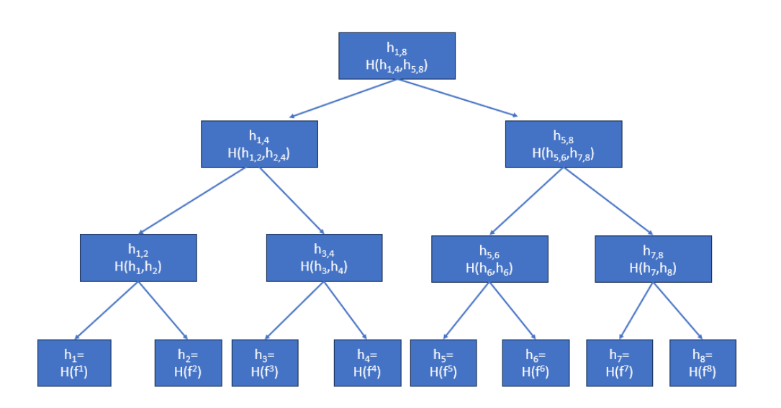
Merkle tree
Merkle tree is a binary tree structure commonly used in cryptography and data verification
It is constructed by hashing data in leaf nodes, then hashing pairs of leaf hashes to create parent node hashes, and repeating until a single root hash is obtained this root hash represents the entire dataset’s integrity
Merkle tree

Slide 5
Shamir’s Secret Sharing Scheme
it allows you to split this secret into n parts (each individual part doesn’t give any information about the secret) and restore this secret upon presentation of k (k¡=n) parts
for example, you have a secret that you want to split into n parts/shares you can divide these shares between your friends (1 share to 1 friend) now when k of your friends reveal their share, you can restore the secret this scheme is also called (k,n) threshold secret sharing

Slide 6
Rate Limiting Nullifier
RLN is a zero-knowledge gadget that enables spam prevention in anonymous vehicle environments the anonymity property opens up the possibility for spam, which could seriously cause many security, data manipulation and the overall functioning of the V2X.
Consider a chat application where users are anonymous now, everyone can write an unlimited number of spam messages, but we don’t have the ability to kick this member because the spammer is anonymous RLN helps us identify and ”kick” the spammer there are also ’nullifier’ and ’external nullifier’, which can be found in the RLN protocol/circuits,

Slide 7
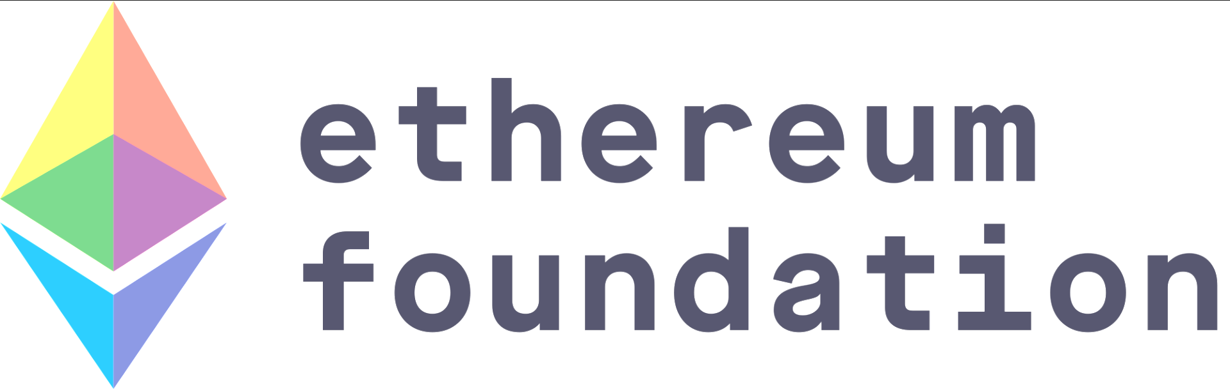

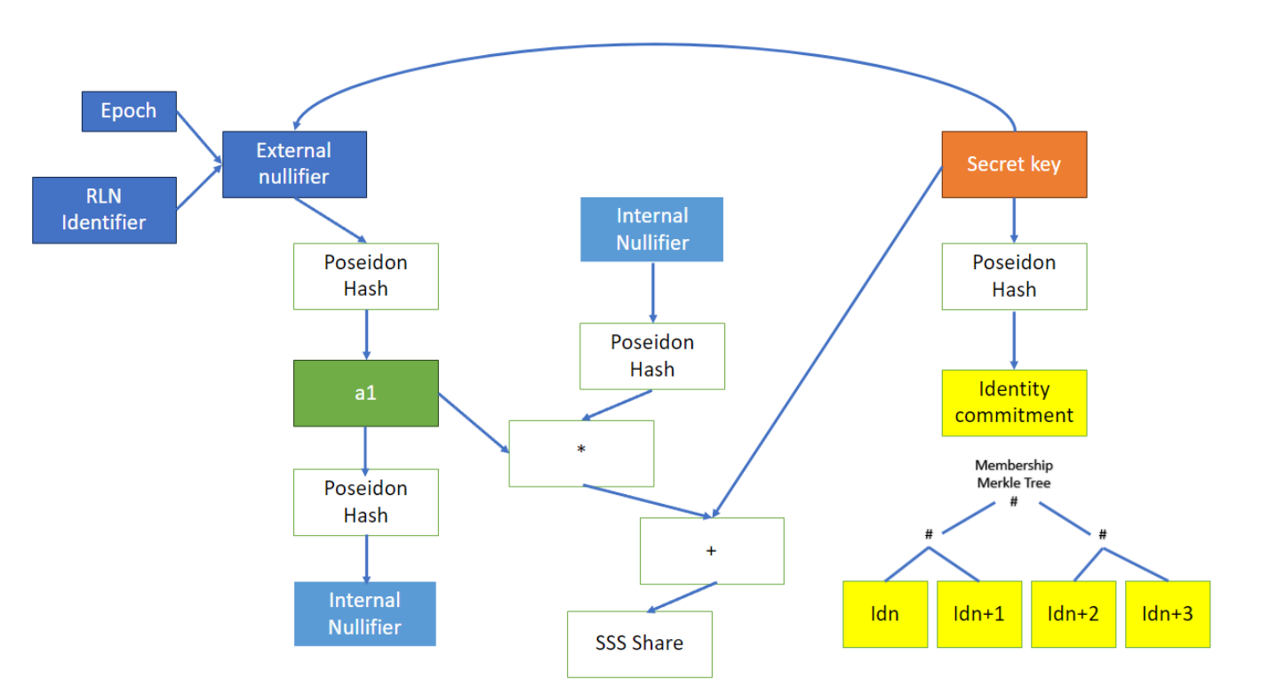
RLN circom circuit
RLN circom circuit

Slide 8
How RLN works?
The RLN construct functionality consists of three parts
Registration
Interaction
Slashing
Registration
the user registers to the application by providing a form of stake vehicle needs to create a Merkle tree, and every participant must submit an identity commitment and place it in the Merkle tree
Interaction
each interaction that the vehicle wants to make with the application, the vehicle must generate a zero-knowledge proof ensuring that their identity commitment (or specifically rate commitment) is the part of the membership Merkle tree
Slashing
it allows for the users to be removed from the membership tree by anyone that knows their secret key thus, if someone spams, it’ll be possible to recover the secret key and withdraw the stake of a spammer

Slide 9
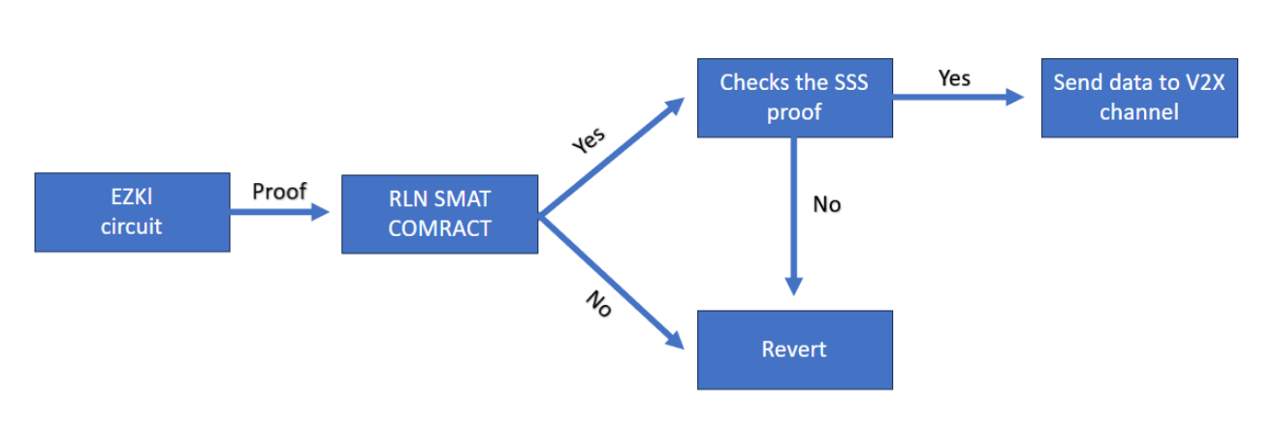
model for ZKAV
. Proposed model for ZKAV

Slide 10
Conclusion
it enables the creation of proofs for various applications such as object detection and number plate recognition
RLN (Ring Learning Network) circuits developed using the circom DSL (Domain Specific Language), which serves as a robust spam protection mechanism for V2X
this innovative system combines machine learning, blockchain technology[12], and cryptographic protocols to create a secure and verifiable environment for applications like object detection and V2X communication it bridges the gap between AI model outputs and secure data transmission, ensuring the integrity of information in emerging digital ecosystems.

Slide 11
Limitations
The limitations of this project arise from the choice of using ethereum[5], a public block chain, for automotive vehicles although private blockchains are better suited for automotive applications
Ethereum smart contracts requires significant computational resources, which could overload the vehicle’s computing capacity
the project faces limitations due to its reliance on ethereum and the computational burden it places on automotive vehicles, necessitating a focus on computational capacity improvements

Slide 12
iSCSi 2023 official Sponsors

